Slide 1





PROFESSIONAL PRACTICES IN IT
CYBERLOCK SOLUTIONS BUSINESS PLAN
Group Members:
Komal Waseem 20L-1114
Nabeeha Mudassir 20L-1080
Nisa Nadeem 20L-1141

Slide 2



AGENDA
I
BUSINESS PLAN
INITIAL INVESTMENT PLAN
II
III
SAMPLE PROJECT PLAN

Slide 3
BUSINESS PLAN
I

Slide 4


CONTENTS
01
VISION STATEMENT & PROFILE
02
MARKET SIZE & TARGET CUSTOMERS
03
REVENUE STREAM
04
VALUE PROPOSITION
05
ECONOMIC & CASH FLOW ASSESSMENT
06
MARKETING & EXPANSION PLAN
07
DAMAGE CONTROL PLAN

Slide 5
VISION STATEMENT & PROFILE
01

Slide 6

VISION AND MISSION
OUR VISION
to be the leading provider of cutting-edge cybersecurity solutions, safeguarding the digital landscape and empowering organizations to thrive in a secure and trusted environment.
MISSION
to deliver comprehensive digital security solutions, leveraging advanced technologies and industry expertise to protect businesses and individuals from evolving cyber threats.

Slide 7
MARKET SIZE & TARGET CUSTOMERS
02

Slide 8


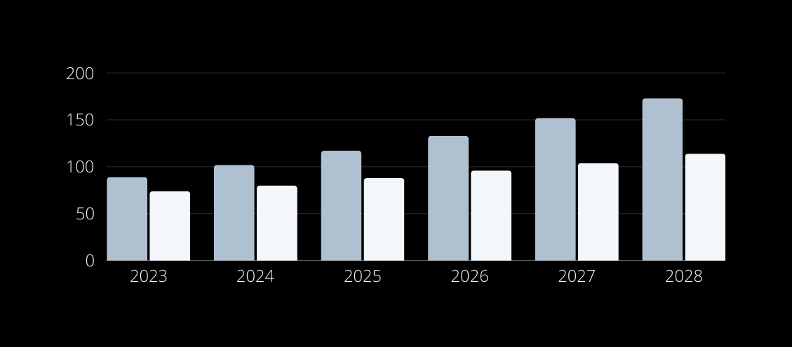
REVENUE AND GROWTH
2023 CYBERSECURITY REVENUE
$163M
2023 Revenue for Pakistan - Cyber Solutions ($89M) and Security Services ($74M)
ANNUAL GROWTH RATE
12.13%
Annual Growth Rate for the next five years (2023-2028)
Notes:
bar chart shows projected revenue for 2023-2028 according to growth rate
- light blue = security services
- white = cyber solutions

Slide 9


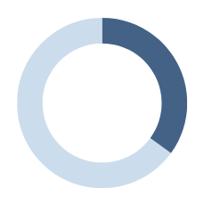

ESTIMATED MARKET SIZE
TOTAL ADDRESSABLE MARKET
Estimated Total Addressable Market (Annual) for Pakistan for the next five years (ranging from $100M to $150M)
$125M
MARKET OPPORTUNITY
Current Market Opportunity for Cybersecurity in Pakistan
35%
TOTAL CYBERSECURITY FIRMS
39
Total firms providing cybersecurity solutions in Pakistan in 2023 (4127 total software companies)
Notes:
total addressable market has been estimated according to prev slide data (revenue and growth rate)

Slide 10





TARGET CUSTOMERS
Government, military, security agencies and law enforcement agencies
Businesses using Automated Software Solutions
Software development companies looking for external cybersecurity solutions
IT Security Consultants

Slide 11
REVENUE STREAM
03
Notes:
CyberLock Solutions, keeping the digital world safe, makes money in different ways to stay financially strong.

Slide 12

Subscription Plans
Educational Workshops
Specialized Programs
03
Notes:
subscription plans designed as protective shields for businesses. These plans not only act as guardians for computers and networks but also include regular check-ups, ensuring an enduring commitment to our clients' digital security."
Beyond subscriptions, we generate income by developing specialized computer programs. These programs are our digital defenders, warding off malicious content such as viruses and hackers.
We believe in empowering our community. That's why we go beyond products and conduct educational workshops. These sessions are designed to teach employees in businesses how to navigate the digital landscape intelligently, helping them avoid common traps set by hackers."

Slide 13
VALUE PROPOSITION
04

Slide 14




ROBUST CYBER SOLUTIONS
INNOVATIVE SECURITY PLANS
Tailored to protect your online presence against evolving threats and malicious activities
Trust that your business is shielded from cyber risks, ensuring a worry-free digital environment.
SIMPLICITY AND STRENGTH
ACCESSIBILITY FOR ALL
What sets us apart is not just the strength of our defenses but the simplicity in keeping you secure.
We believe in making cybersecurity accessible to all businesses, providing peace of mind through user-friendly solutions.
.......
Notes:
CyberLock Solutions aims to provide robust cyber solutions which will provide protection against malicious activities and threats. We aim to solve cybersecurity related problems in an innovative way while keeping our security mechanisms simple and user-friendly. Our strong defenses will provide our customers with security in their applications in the best possible way. And we also aim to make our solutions as accessible as possible.

Slide 15
ECONOMIC & CASH FLOW ASSESSMENT
05

Slide 16

Year ending on 31st December, 2023 | 2023
CASH OUTFLOW
Salaries | ($300,000)
Office rent | ($36,000)
Utilities | ($12,000)
Software Licenses | ($50,000)
Taxation | ($20,000)
Marketing Expenses | ($80,000)
Interest and Loan Repayments | ($15,000)
Net Cash Outflow | ($513,000)
CASH INFLOW
Return on Investment | $50,000
Revenue | $500,000
Funding | $350,000
Net Cash Inflow | $900,000
NET CASH FLOW | $413,000
CASH FLOWS
Notes:
We conducted a cash-flow assessment by researching similar companies. By gathering the data of cybersecurity-related software houses, we estimated our cash outflows and inflows for the year 2023 as shown in the table. Our outflows are employee salaries, office rent, utilities, software licenses, taxation, marketing expenses and interest and loan payments. So all of these sum up to be approximately $513,000. On the other hand, our inflows include ROI, revenue, and funding. These sum up to be around $900,000. Therefore, we can clearly see that this is a positive cash flow for our company which depicts a robust growth.

Slide 17
MARKETING & EXPANSION PLAN
06

Slide 18

MARKETING PLAN
PAID ADVERTISING
SOCIAL MEDIA MARKETING
targeted Google Ads and Social Media Ads on Instagram, LinkedIn and Twitter, television ads and billboards
strategically use social media platforms like LinkedIn and Twitter, sharing engaging content and running social media campaigns
MARKETING STRATEGIES
EVENT MARKETING
EMAIL MARKETING
company representatives actively attend cybersecurity-focused events, conferences, webinars and workshops
cultivate direct connections by maintaining a sizable email list, ensuring regular updates and exclusive content for clients and cybersecurity community.
Notes:
We aim to employ 4 marketing strategies. The first one is Paid Advertising in which aim to use targeted ads on social media as well as Google ads. We also aim to use trad methods of ad such as tv ads and billboards. Secondly, we aim to use social media marketing by running effective social media campaigns and sharing engaging content. Thirdly, we will be using event marketing by having our team reps attend cybersecurity based events to promote our company and connect with relevant people. The fourth strategy is email marketing. We will maintain a list of emails and promote our company by sending regular updates and exclusive content.

Slide 19

PRODUCT DEVELOPMENT
offering customers innovative and new products that meet their changing needs and preferences
Predictive Threat Intelligence: utilizing AI algorithms to predict and identify emerging cybersecurity threats.
AI-Powered Endpoint Protection, in which we integrate machine learning models into endpoint security solutions to identify and prevent new and evolving malware threats.
EXPANSION PLAN
MARKET PENETRATION
Maximizing the use of existing resources
Enhance Product Features: Improve endpoint protection solution with ML algorithms
Revise pricing strategies: introducing tiered pricing plans to cater to different-sized businesses, making the solutions more accessible to smaller enterprises.
We could also offer limited-time discounts
Notes:
For our expansion plan, we currently intend to use two strategies: prod dev and market penetration. prod dev refers to offering new prods to meet the changing needs of customers. we aim to do this by providing predictive threat intelligence and ai-powered end point protection. on the other hand, market penetration refers to maximizing the use of existing resources. we plan to do this by enhancing our product features by utilizing ai, revising our pricing strategies to provide tiered pricing plans, and by offering limited time discounts.

Slide 20
DAMAGE CONTROL PLAN
07

Slide 21
IDENTIFIED RISKS
MARKET COMPETITION
highly competitive field, many dominant players
TECHNOLOGICAL COMPLEXITY
rapid growth of technology, advanced threats, compliance, integration challenges
REPUTATION RISKS
experiencing a data breach or security incident, services do not perform as promised or fail, slow customer support

Slide 22
RISK PLANNING
MARKET COMPETITION
flexible marketing methods, customer-centric focus, quickly adapt to changing landscape
TECHNOLOGICAL COMPLEXITY
employ highly skilled professionals, collaborate and partner, continue learning, compliance management, testing and QA
REPUTATION RISKS
rigorous security measures,penetration testing and vulnerabilityassessments, comprehensive incident response plan

Slide 23
INITIAL INVESTMENT PLAN
II

Slide 24


INVESTMENT PLAN
SOURCES OF FUNDING
Venture Capitalists e.g Sarmayacar which funded Bykea
Business Angels e.g Angel Investment Network PK
Overdraft Loans e.g Youth Entrepreneurship Scheme by Allied Bank
RISKS
Reliance on Individual’s Decision
Limited Funding Capacity
Equity Dilution
High Expectations from Rapid Growth
EXIT STRATEGIES
Acquisition
IPO (Initial Public Offering)
Buyback Agreement

Slide 25
SAMPLE PROJECT PLAN
III

Slide 26


SECUREVAULT: ADVANCED DB SECURITY
PROJECT OVERVIEW
database security application
confidentiality, integrity and authentication
client: ABC Bank
KEY FEATURES
data encryption and access controls
anomaly detection
intruder detection
automated patch management

Slide 27
SECUREVAULT: ADVANCED DB SECURITY
KEY DELIVERABLES AND MILESTONES
Requirements Analysis and Security Mechanisms Research
System Design and Architecture
UI Design
System Development
Testing and Quality Assurance
Deployment and Maintenance
PROJECT TEAM
project manager, requirements engineers, data scientists, cybersecurity experts, database engineers, developers, QA, compliance specialists, UI designers

Slide 28
THANK YOU

